Slide 1
Confidence in your Professionalism
Thursday 16th January
Emma Baillie, Vanessa Blore and Katie Day

Slide 2
Session Intentions
Reflect on your first impressions.
Challenging conversations

Slide 3
1. Reflect on your first impressions.
Notes:
Take a moment to think about how you have settled in to your school.
You may have trained there. You may have been there for four, months, a year, even longer.
What conscious or sub-conscious decisions have you made to appear professional to your colleagues and wider school community?

Slide 4
Dress code.
Email correspondence.
Awareness of the ‘chain of command’.
Un-structured colleague time.
Socialising out of school.
Setting professional boundaries
Uphold the school systems and role model professional behaviours.
Notes:
Things to be consciously mindful of to protect and enhance your professionalism.
Dress Code – stay within the expectations of the dress code. Look to peers and other staff members you look up to, to get a feel for what is appropriate or not. Often the clothes we wear helps us to feel confident in our classroom but it also needs to show we respect the school policy.
Email – Consider your email tone. If in doubt opt for a more formal tone to colleagues, students and parents. Beginning with Good morning, Good afternoon, sign of with Best regards, or thank you. Avoid one line, emails unless you have an established communication with that person.
Remember that emails are a paper trail. You should feel happy that anything you write could be dug out in years to come and would reflect you professionally. Avoid sending emails out of working hours – use schedule send to support your own work-life balance.
Chain of command – In all schools there are chains of command. You have a mentor, line manager, senior leaders, etc. Follow that line of command when it comes to questions, queries or following up on students. Avoid emailing SLT with information that could be recorded through a given process such as Classcharts or CPOMS (unless you feel it is urgent). That does not mean to say that you cannot arrange to meet with them to discuss something important but those processes and lines of responsibility are there to manage workload at all levels so try to be mindful of this.
Un-structured time – be aware that some members of staff in school may behave or speak in a way that others may deem unprofessional – that does not make it ok. Remember your own expectations and avoid ‘joining in’ with others to foster friendships, etc. You are still at work and role modelling professional behaviours.
Out of school – Be aware that wherever you are there may be a parent, ex-student, colleague, friend of… etc. We all need to vent and moan, but be careful with your word choices. Avoid naming people, places, schools, etc. Be mindful when you’re out and about – you may bump into students shopping for example. This can work in your favour in building relationships if handled in a friendly and cheery way.
Boundaries Work – life balance – taking work home, responding to emails, Do what works for you. Perhaps avoid shouting about it. Talk to your mentor or close colleagues.
School Systems and professional behaviours – be where you’re expected to be. Challenge behaviour, uniform. Uphold expectations of uniform, equipment, etc.

Slide 5
2. Challenging Conversations
Reflect:
What common difficult conversations might you have with parents?
Notes:
AL
Ask delegates to share their thoughts on common ‘difficult situations’ to do with parents
On calls
Homework
Bullying issues within the class
Bullying issues as a tutor
Disagreements regarding sanctions
Student thinks you’re picking on them
Student finds the work too hard
Parent thinks you’re not taking into consideration a SEN need

Slide 6
Difficult Conversations with Parents
Do Now:
What common difficult conversations might you have with parents?
On calls
Homework
Bullying issues within the class
Bullying issues as a tutor
Disagreements regarding sanctions
Student thinks you’re picking on them
Student finds the work too hard
Parent thinks you’re not taking into consideration a SEN need
Notes:
AL
Ask delegates to share their thoughts on common ‘difficult situations’ to do with parents

Slide 7
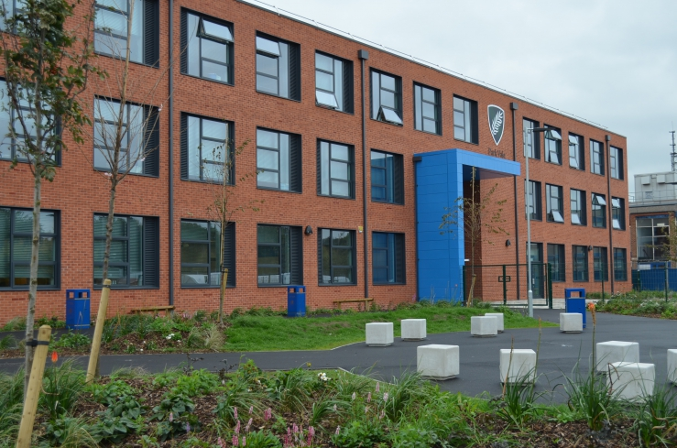
Introduction
We, not I
Notes:
AL
Ask delegates to share their thoughts on common ‘difficult situations’ to do with parents

Slide 8
1. The difficult conversation shouldn’t be the first one
Notes:
AL
Ask delegates to share their thoughts on common ‘difficult situations’ to do with parents

Slide 9
2. Prepare
Notes:
AL
Ask delegates to share their thoughts on common ‘difficult situations’ to do with parents

Slide 10
3. Get in first
What if the parents don’t believe you?
This says more about them than you. You will not win every conversation.
‘As an adult in a professional setting, we would not make up events. We have nothing to gain from this.’
Notes:
AL
Ask delegates to share their thoughts on common ‘difficult situations’ to do with parents

Slide 11
4. Clarity and Professionalism
Professionalism goes without question. Do no get drawn into an argument. Avoid personal opinions or criticism of either parties. Don’t tolerate any swearing.
‘His behaviour is rude’ to ‘……….needs to communicate his frustrations in more helpful way’
If you feel the conversation is no longer productive, politely draw it to a close and offer to reconvene with a senior staff member to support.
Notes:
AL
Ask delegates to share their thoughts on common ‘difficult situations’ to do with parents

Slide 12
5. Listening and Patience
However misguided they may be, they ultimately want the same thing as the school. They just have a different view how to get there.
‘I understand your frustrations’ ‘I hear what you are saying’
Notes:
AL
Ask delegates to share their thoughts on common ‘difficult situations’ to do with parents

Slide 13
6. Focus on a solution
This is when a plan going into the conversation can be important.
Go in with a solution but be open to a collaborative approach with the parent, within reason. If you need help on a solution speak to your CTL, HOH or SLT.
‘What can we do to fix this?’
‘In the future we will try this…’
‘This will help your daughter to….’
‘Your support at home can be really beneficial…’
Notes:
AL
Ask delegates to share their thoughts on common ‘difficult situations’ to do with parents

Slide 14
Top tips
Know the behaviour policy and sanctions process inside out- no wriggle room
Stick to your guns- the systems aren’t changing no matter how much they don’t like them
Sanctions are found in all schools- parents don’t know how schools work a lot of the time- our schools are not exceptionally strict or mean
‘This a standard rule across all schools in the country’
The parent has one child to worry about you have 100s- parents forget this
Parents have their own mental health/SEN issues
Parents are not always rational or reasonable so don’t expect it
They cannot demand a call from you when it suits them- you call when it suits you
If you make a mistake- own it and fix it- be honest
Stay with the facts
Try to be proactive rather than reactive
Notes:
AL
Ask delegates to share their thoughts on common ‘difficult situations’ to do with parents

Slide 15
Key phrases
‘As an adult in a professional setting, which takes years of training, we would not make up events. We have nothing to gain from this.’
‘His behaviour is rude’ to ‘……….needs more support with communicating his frustrations so we can help in those moments’
‘I understand your frustrations’ ‘I hear what you are saying’
‘What can we do to fix this?’
‘In the future we will try this…’
‘Your support at home can be really beneficial…’
‘We need your help’
‘This is a trust rule and we have to hold the line to ensure safety and order’
Notes:
AL
Ask delegates to share their thoughts on common ‘difficult situations’ to do with parents

Slide 16
Problem Solving

