Slide 1
Tutor Time Team Challenges
Try dividing your tutor group into Team A and B
As and when you find it useful, use one of the 12 challenges (very little or no prep required)
Click on the link on slide 3 to take you to the challenge
Keep a Team A versus Team B score card on the wall.(laminate it to make updating scores easy)
Award a prize to the winning team at the end of the term

Slide 2
Tutor Score card
Team A
Team B

Slide 3
Wait a minute !
Reaction Times
Mr & Mrs
Straight Line
The Plank
Blind challenge
Pressing Up
Chinese Whispers
2 feet
Memory Challenge
Word challenge
Bouncy Ball Box

Slide 4

Do you know how long a minute is?
Wait a minute !
Back

Slide 5
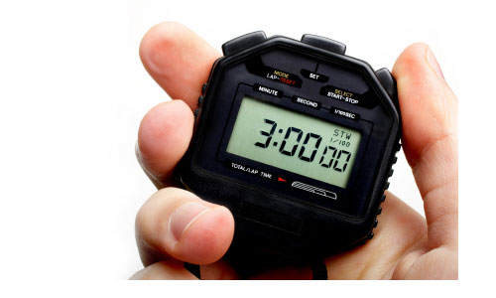
What to do….
Equipment
1 x stopwatch
-could even be on a watch or a phone?
Quick game : The winner wins it for their team!
OR
Try 2 minutes or 3 minutes for the final.
Start a stop watch at the front of the class.
In silence each student sits down when they think exactly one minute has passed.
The tutor will not show any reaction at all when the clock hits 60 secs and waits until all students are sitting down
The tutor should mentally note which student got the closest to 1 minute and reveal at the end.

Slide 6

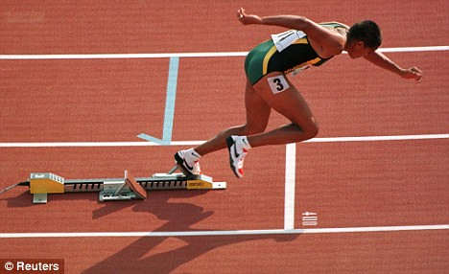
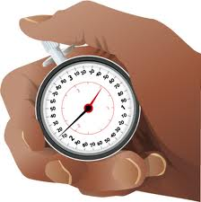
Reaction timest?
Back

Slide 7
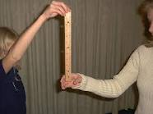
What to do…
Equipment
1 x 30cm ruler
The tutor (or another student) holds up the ruler by the 30cm end
The student opens fingers and thumbs at either side of the ruler at 0cm (not touching the ruler)
Whenever the tutor wants they release the ruler.
The student reacts as quickly as possible by grabbing the ruler with finger and thumb ONLY !!
The student with the fastest reactions is the student who grabs the ruler at the LOWEST measurement.
Eg. 12cm is better than 18cm.
Who wins…You could decide to take an average Team A score and an average Team B score and see who wins…

Slide 8

Mr & Mrs
Who knows more about their friends?
Back

Slide 9
What to do…
Equipment
Pre-prepared questions to ask the teams about each other.
Names of all students in a hat to randomly select those who will play
Allow the students 5 mins as a group of girls and a group of boys. The idea is that they use the time to share as much information as possible about each other…hobbies, family, pets etc.
After the 5 mins draw 2 girls names and 2 boys names out of a hat. Send 1 boy and 1 girl out of the room
The remaining boy or girl should stand at the front facing you and answer questions about the boy or girl who is waiting outside. Eg. “How many sisters do they have?”
After you have asked the 5 questions and noted responses invite the 2 students back in. They must face you at the front and not make contact with their peers.
Ask them the same questions about themselves and mark whether their partners got them right or wrong.
Who wins…Whichever team got the most correct answers out of 5
In the event of a draw ask a tie brake question. Send the opposite student out and ask one from selected tie breakers.

Slide 10
Sample questions…choose 5
How many brothers and sisters do they have?
What is their favourite subject?
How is their best friend?
What Primary school did they go to?
Name one of their pets?
What street do they live on?
What is the name of their brother or sister?
What is their favourite sport?
What is their favourite hobby?
Who is their favourite band or singer?
What is their Mum’s name?
How many pets do they have?
TIE BREAKERS (must be number answers)
How old is their Mum?
What is their house number?
What is their lucky number?
How many cousins do they have?

Slide 11
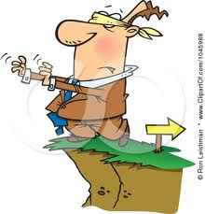
Straight line
Can you walk in a straight line…..
……blindfolded ?
Back

Slide 12

What to do…
Equipment
A scarf or blindfold (make sure they can’t see down)
A strip of coloured paper approx 3m in length
(notice board edging paper roll is ideal)
Take it in turns, Team A then B etc to walk blindfolded along the paper strip.
Take care to place their right foot exactly on the strip before they start.
They must stay touching the line with each foot placed.
As soon as a foot is placed on the floor and not touching the paper, their turn is over.
Mark with a counter or mark the paper where the furthest person got to. Mark the front of their last “good foot”.
Keep moving it along as someone beats the previous record.
Who wins…Whoever is the champion and makes it furthest along the line wins it for their team!
Should more than one person complete the whole line, you could have a final walk off and maybe extend the line or make it zig zaggy!

Slide 13
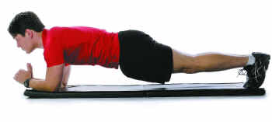
The Plank
Who is the strongest……?
Back

Slide 14
What to do…
Equipment
Absolutely nothing!
Who wins…Whoever holds the plank position for the longest wins it for the boys or the girls.
Variation might be to select 3 from team and 3 from team B and allocate 1 point for first out, 2 pts second out etc until the last person “planking” gets 6 points. Add them up to see who gets more points …
The plank position is toes on the floor, leaning on forearms, keeping the body flat as shown
The aim is to hold the plank position for as long as possible.
You will decide amongst you who to nominate for the challenge after practicing for 5 minutes.
One team A versus one team B

Slide 15

Blind Challenge
Who is the strongest willed?
Back

Slide 16
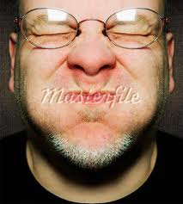
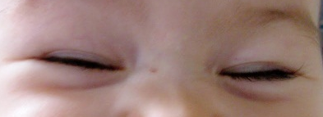
What to do…
Equipment
Absolutely nothing!
Every person in the form stands up behind their chair facing the front.
They can not touch anything or speak
When you say GO they close their eyes! Simple!
Watch carefully and check that no one opens them and peeps.
Anyone who opens their eyes is out, but they must stay standing there and not move or sit down.
If everyone stays silent the people left in will not have any idea who is left….or indeed whether anyone else is left
It sounds easy but try it…it’s really uncomfortable.
Who wins…
Last person wins it for their team!
Those who have opened their eyes and are out can help check on the others for cheating…but they must do this silently.

Slide 17
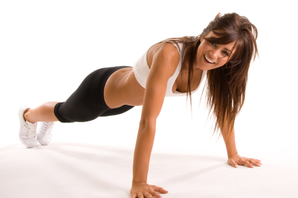
Pressing Up
How many press ups can you do?
Back

Slide 18

What to do…
Equipment
Stopwatch, calculator
Pair up the form with a member of the opposite team
Get the team A person to get in the press up position, the partner is to count how many press ups they can do in the time.
Time 30 seconds whilst they do their press ups
Add up the total number of press ups for the team
Repeat for team B
Who wins…
The team with the biggest total number of press ups!

Slide 19
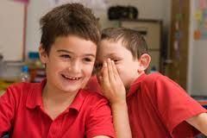
Chinese Whispers
Who can
whisper more clearly?
Back

Slide 20

What to do…
Equipment
A passage of approximately 3 sentences (try and make it relevant to you or your form / House) (egs on next slide)
2 pieces of paper
Who wins…
The student at the back of the line take turns to read out what they have written.
You are the judge.
Which group most accurately represented what you said?
Split into 2 teams teams in a long row front to back of class room
You should try to have one pace
(50-100cm) between them
Tutor whispers the passage to the front member of each team
It can only be read to them once
At the same time the teams start to whisper what they heard to the person behind
Check that the next person in line can not hear what the 2 in front have said.
The last person in line listens to the person in front once and then goes away to write down what they heard.

Slide 21
Examples for the whisper passage
Africanus House are clearly the best house, as we won the the House cup last year. We need to improve our academic performance though as the others seem to beat us quite a lot. I wish ARH would stop winning everything though, it’s really frustrating!
or
I am really looking forward to Christmas this year I hope that Santa will bring me lots of chocolate and some Gucci perfume. My friend wants tickets to see Peter Andre, but I can’t possibly take her , it would be so embarrassing. I much prefer Cliff Richard!

Slide 22
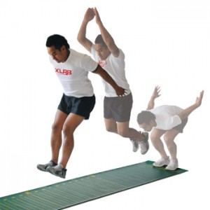
2 feet
Who can jump further?
Back

Slide 23
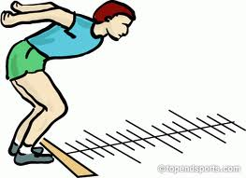
What to do…
Equipment
A strip of paper to mark the starting point.
A tape measure or 1m ruler
Paper to record the scores
Who wins…
The student who jumps the furthest wins it for their team!
Clear a gap in your classroom and set down a strip of paper on the floor as a starting marker.
Lay out a tape measure or meter ruler ahead of the line
Students should have one practice go each to refine their technique
They must stand with both feet BEHIND your starting line
They then jump with both feet together as far as they can
They MUST stand still as they land
Measure how far they have jumped from start line to the BACK of their foot
After a practice turn each all students to have one turn each.

Slide 24

Memory challenge
Who has the best memory?
Back

Slide 25
What to do…
Equipment
Each student needs a slip of paper and pen
Who wins…
Work out the average team score
Biggest average wins!
Show the next slide for a total of 1 minute
Explain to the students that you are about to show them an image with 20 objects on . They will have 1 minute to memorise as many of them as possible.
Discuss possible techniques BEFORE THEY SEE THE SLIDE
EG making a story up connecting the pictures, group related items together and memorise them as a group.
Show the next slide for a total of 1 minute
Click onto the next slide and hand out pieces of paper.
In silence give them 2 mins to write down what they can remember
Swap papers reshow the slide and mark each others.

Slide 26
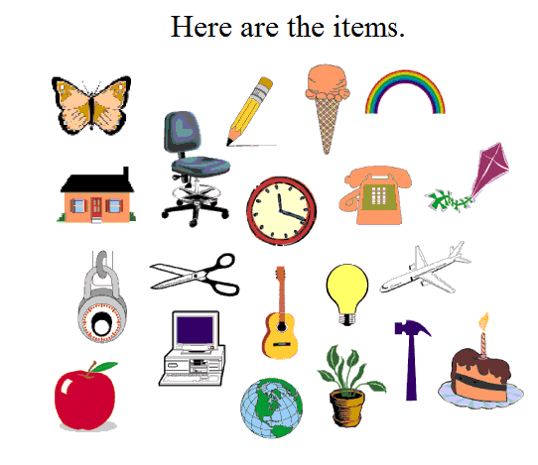

Slide 27
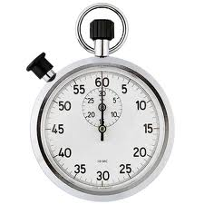
Time’s up!
You now have
2 mins
to write down as many items as you can remember

Slide 28

Word challenge
Who can create the most words?
Back

Slide 29

What to do…
Equipment
Each student needs a white board or scrap of paper ,
2 pieces of A3 paper (one for each team)
Who wins…
Total up the girls and the boys words
Allow time to check those words confirming spelling as a group
Team with the biggest total wins
Explain that a word will be put on the screen
As a whole team they must make as many words as possible using the letters in the word or phrase displayed
Each letter can only be used ONCE. As many or as few letters as they want can be used.
Time allowed = 5 mins
Eg. If the word was
EDUCATION
Suitable words are : Cat, Tea, Date, Note etc etc
Advise your teams that organisation is the key, co-ordinating words, collating them efficiently.
Great activity which you can repeat later in the year by simply changing the word !

Slide 30
Your word / phrase is……
GREAT BRITAIN

Slide 31
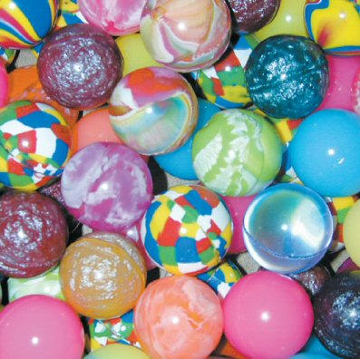
Bouncy Ball Box
Who can get the ball in the box the most times?
Back

Slide 32
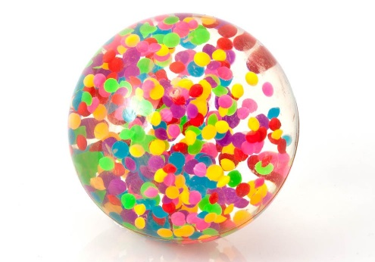
What to do…
Equipment
A bouncy ball…any size
A box of any size, or bucket, or empty bin!
Who wins…
Option 1
Within a given time frame say 5 or 10 mins (decided at the start), the team who scores the most points.
Option 2
You could vary this game by starting with the box on the second desk, everyone who scores stays in, the box gets moved to the third desk etc……keep playing until the last “man” standing wins
Place the box or bucket on the 3rd desk or table back in the room.
Line the students up alternate team A team B etc in a queue.
Each student to take it in turns to bounce the ball on the front desk, causing it to bounce on the second desk also before scoring a point with it landing in the box or bucket.
You can vary which desk you place the box on to vary the difficulty.

Slide 33
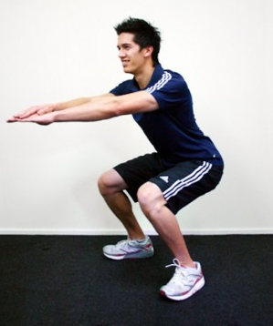
The Chair
Who has the
strongest legs……?
Back

Slide 34
What to do…
Equipment
Absolutely nothing!
Who wins…
Whoever holds the plank position for the longest wins it for their team
Or extra points for the last ones in
The plank position is toes on the floor, leaning on forearms, keeping the body flat as shown
The aim is to hold the plank position for as long as possible.
You will decide amongst you who to nominate for the challenge after practicing for 5 minutes.

