Slide 1
Some of
S
  What is the Core Purpose of Tutor Time?
^
Build positive relationships
Develop a sense of belonging and ownership
Improve learning
Raise attainment
Create leadership opportunities
Encourage support and communication
Improve reading
Improve organisation skills

Slide 2
Context
Horizontal Tutor system
Vertical Tutor system
Y7
Y8
Y9
Y10
Y11
A B C D E

Slide 3
Context
Horizontal Tutor system
Vertical Tutor system
Y7
Y8
Y9
Y10
Y11
A B C D E

Slide 4
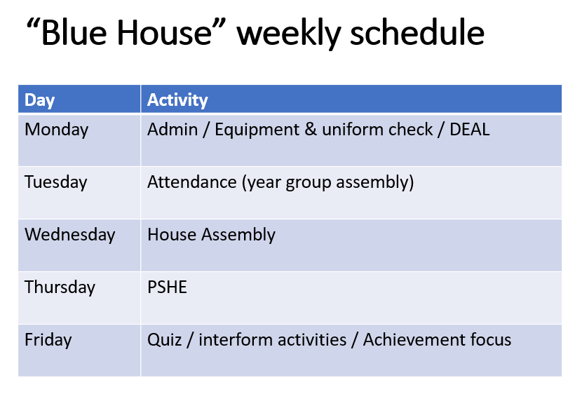
Structure
Formal structure
Informal structure
A list of responsibilities
Tutor to organise the week to achieve this

Slide 5
Other differences
Before Period 1
Middle of the day
No co-tutor
Have a full-time
co-tutor
30 mins
15 mins

Slide 6
Expectations
Fine balance between “more relaxed” atmosphere
and still formal and structured
Seating plan
Participation
Role models
Punctuality
Respect

Slide 7
Relationships
With a trusted respectful relationship, you will have more honest and effective conversation
First point of contact
Student and parent “go to”
Investing in the relationship to encourage openness
  Praise
  Take an interest
  Encourage
  Have fun
Contact parents and encourage them to attend reviews and speak to you with concerns

Slide 8
Difficult conversations
Prepare for an informed and balanced conversation
Student
  Attendance
  Behaviour issues
Parents
  Parent review meetings
  Phone calls in and out
Prepare.
Think about what and how you are going to say
Think through potential responses and how you would deal with it.
Make sure you include positive comments

Slide 9
Structure and Activities
Form or use a structure to make effective use of short tutor times
Messages
PSHE
Review report / exam results
Cotutor / responsible student
One to one time
FUN – team and relationship building

Slide 10
Tutor Score card
Team A
Team B

Slide 11
Wait a minute !
Reaction Times
Mr & Mrs
Straight Line
The Plank
Blind challenge
Pressing Up
Chinese Whispers
2 feet
Memory Challenge
Word challenge
Bouncy Ball Box

Slide 12
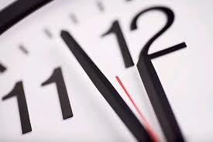
Do you know how long a minute is?
Wait a minute !
Back

Slide 13
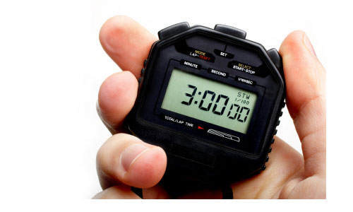
What to do….
Equipment
1 x stopwatch
-could even be on a watch or a phone?
Quick game : The winner wins it for their team!
OR
Try 2 minutes or 3 minutes for the final.
Start a stop watch at the front of the class.
In silence each student sits down when they think exactly one minute has passed.
The tutor will not show any reaction at all when the clock hits 60 secs and waits until all students are sitting down
The tutor should mentally note which student got the closest to 1 minute and reveal at the end.

Slide 14
Reflection
If this is the most challenging 30 mins of your day….
    Why?
    How can you improve things?

